Slide 1


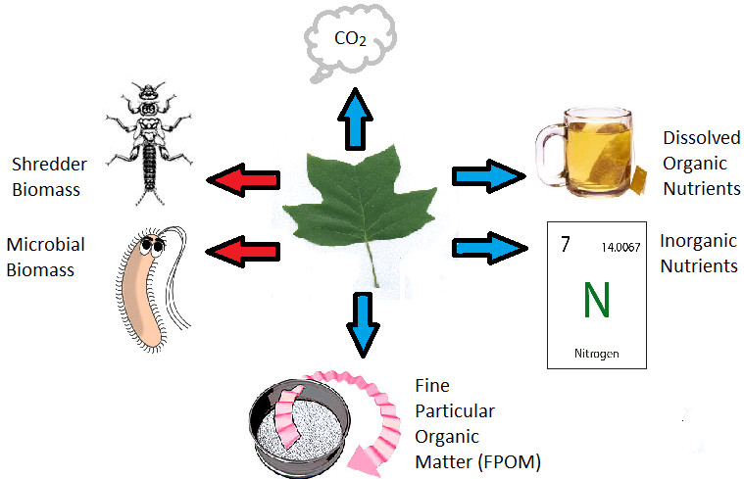
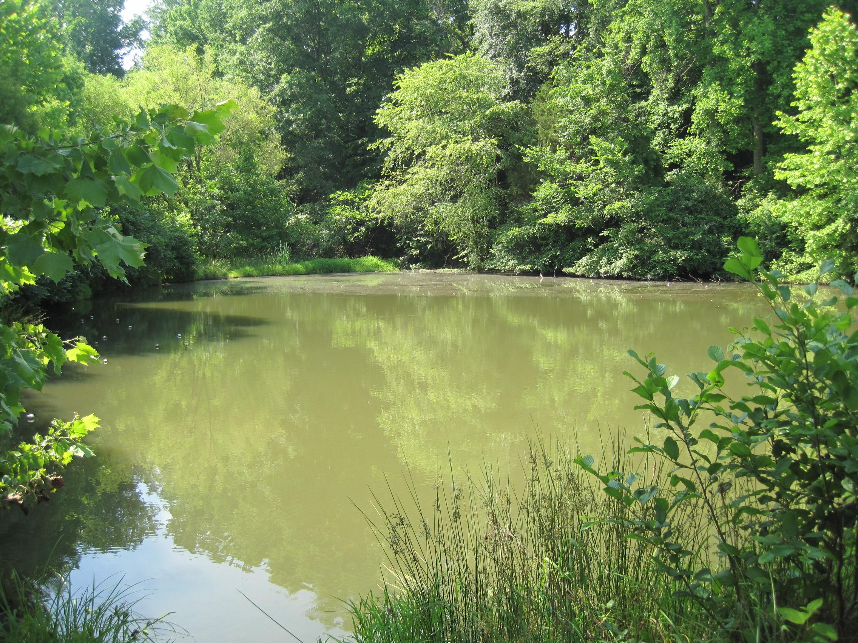
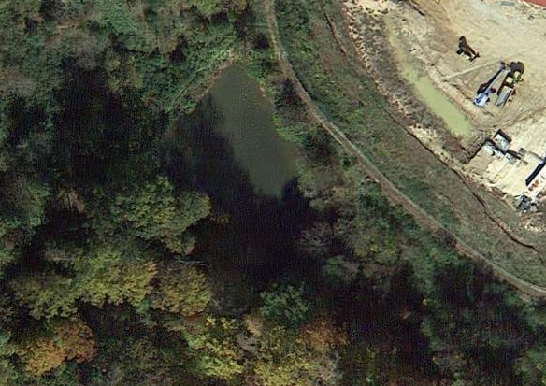
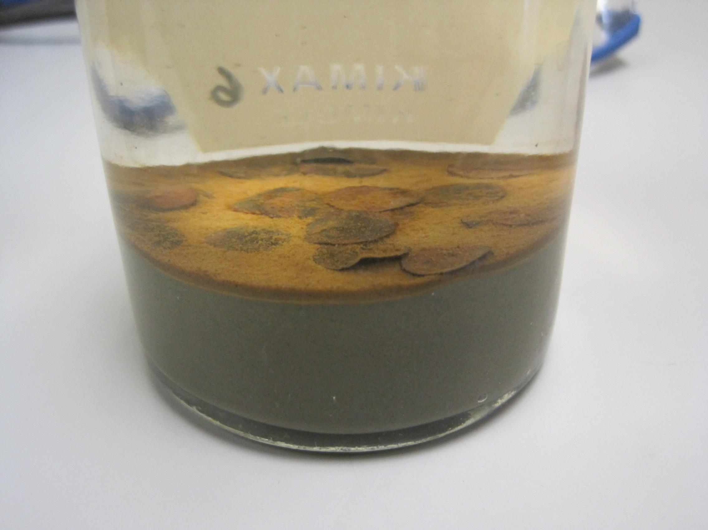
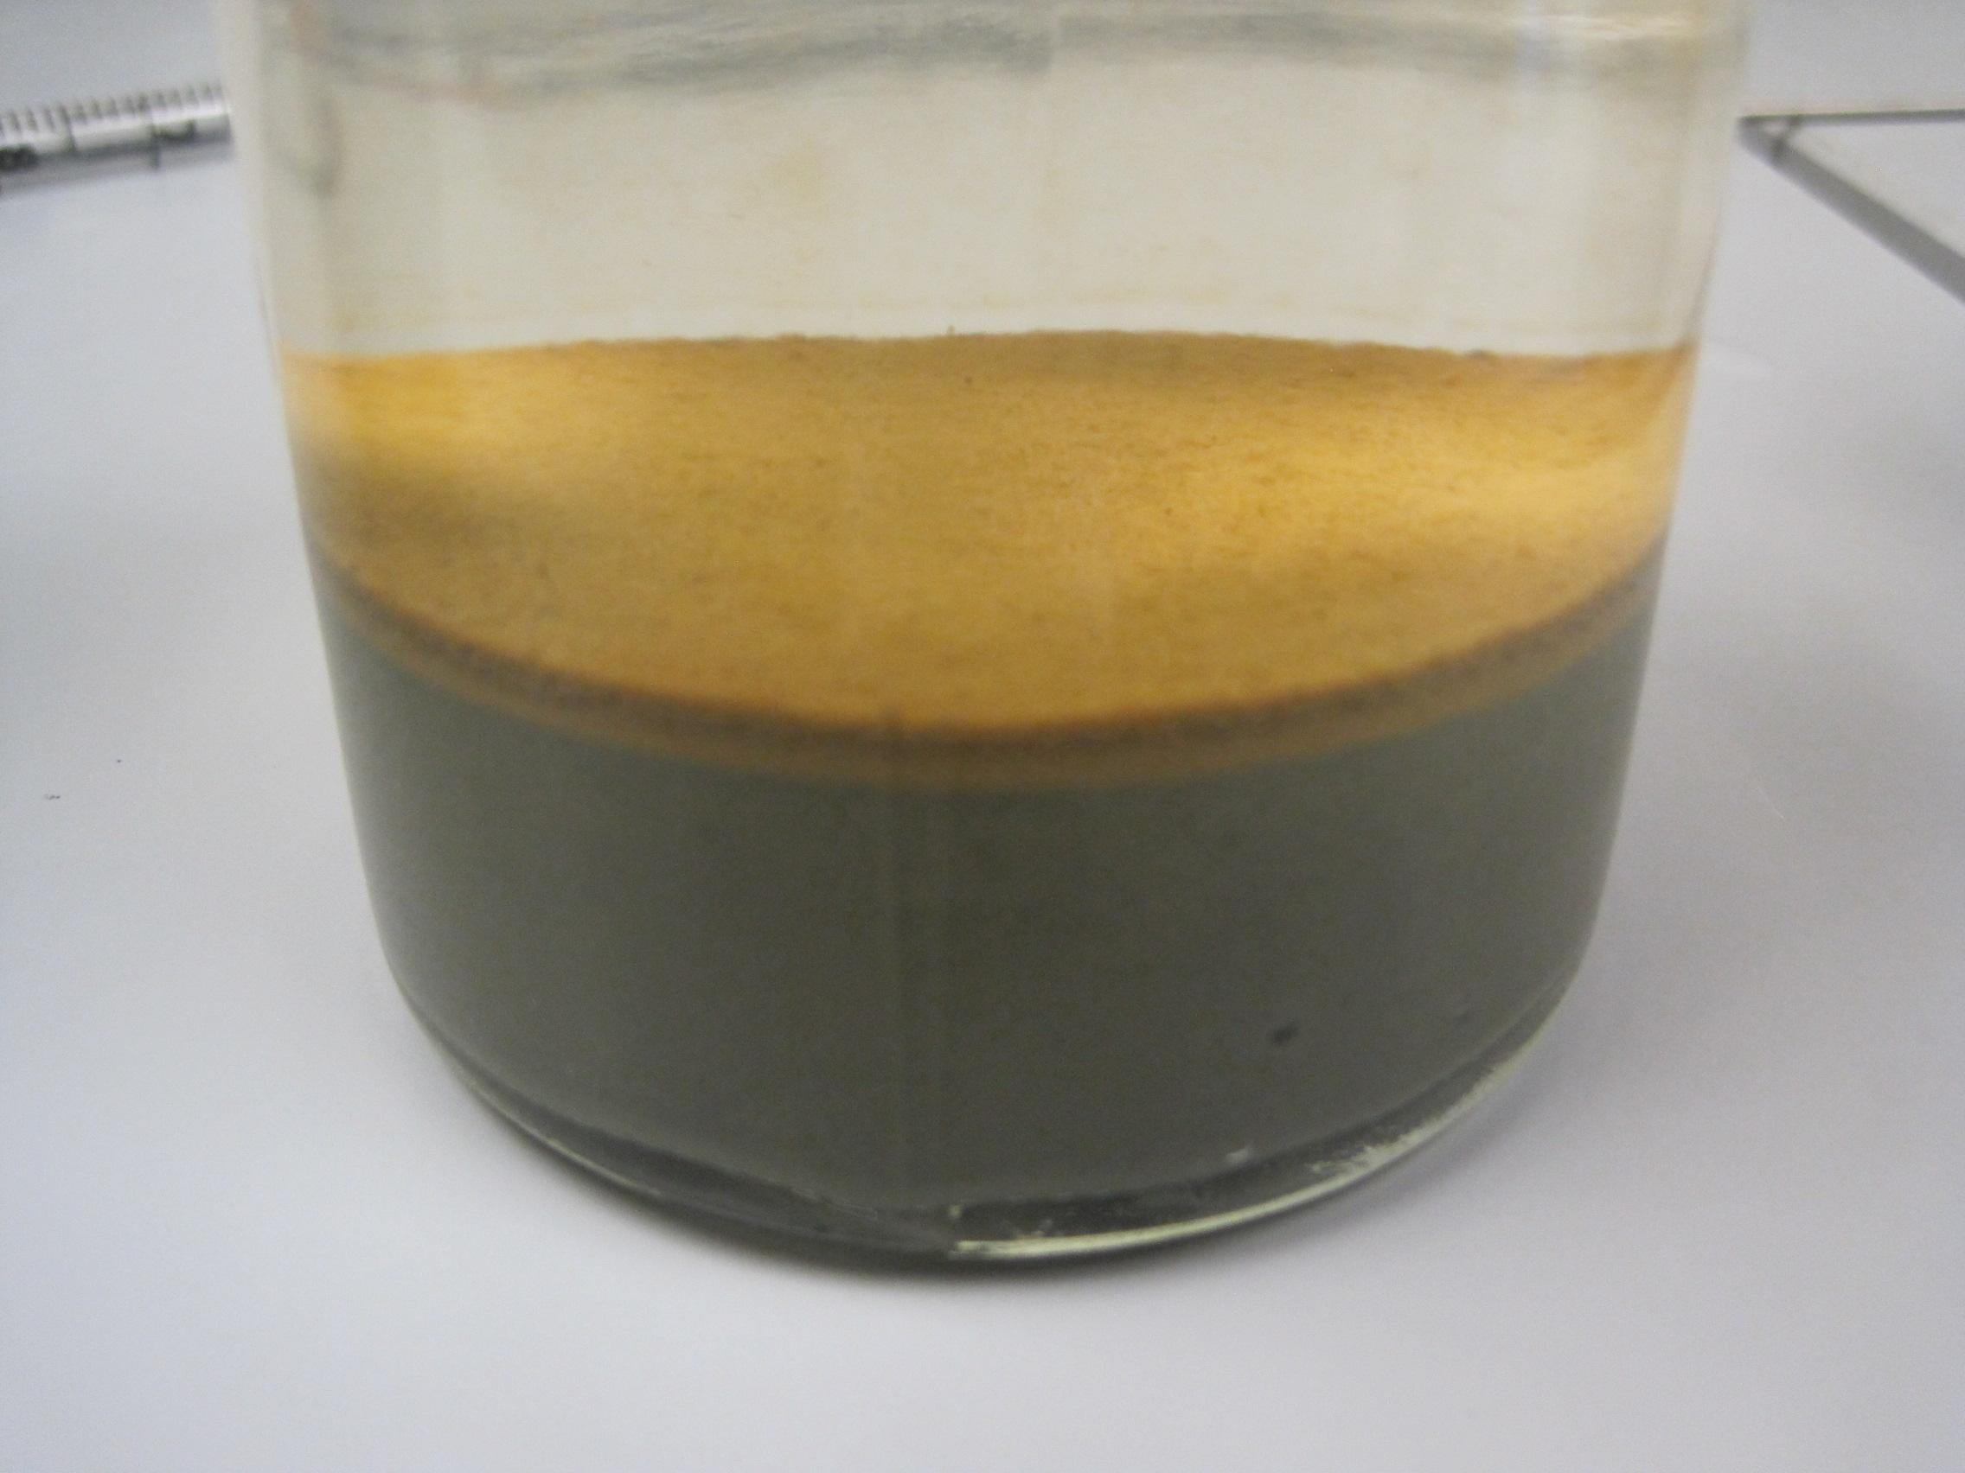
THE EFFECTS OF LEAF LITTER AND NUTRIENTS ON SEDIMENT OXYGEN DEMAND IN A MAN-MADE POND IN CENTRAL VIRGINIA
Kaitlyn D. Peters and Kenneth Fortino
Longwood University, Farmville, Va
Abstract
Results
On a global scale, the abundance and surface area of man-made ponds is nearly equal to that of natural ponds (Downing 2006). Despite this, little is known about the biogeochemical nutrient cycling of man-made ponds. Recent research suggests that leaf litter is an important resource in ponds because it is abundant, variable, and decomposes slowly (Fortino unpublished data). In order to better understand its significance, we simultaneously tested the effects of leaf litter (20, 1 cm senecent tulip poplar leaf disks) and nutrient enrichment (300 μg L⁻¹ DIN + 30μg L⁻¹ DIP) on sediment oxygen demand (SOD). The experiment utilized a complete factorial design, with four replicates for each treatment combination. The sediment mesocosms were created in 300 ml BOD bottles using fine (< 250 μm) sediments and water collected from a small man-made pond in Farmville, Va. The mesocsoms were incubated in the dark for 22 days and sediment oxygen demand and absorbance was measured at 1, 3, 8, 15, and 22 days. We found that both leaf litter and nutrient enrichment increased sediment oxygen demand, normalized to sediment organic matter content, but there was no interaction between leaf litter and nutrient levels. Spectroscopy scans revealed that the labile organic matter initially increased in the leaf litter treatments, but then declined and stabilized on the last two samples dates. The effect of leaf litter on SOD was greatest at 2 and 7 days of incubation and not significant after 21 days. These results indicate that sediment metabolism in this system is limited by organic matter quality and nutrients and that leaf litter can temporarily increase the availability of labile organic substrates.
Leaf Litter Effects
Nutrient Effects
Effects on OM Quality
Fate of Leaf Litter in Ponds
A comparison of the average sediment oxygen demand (SOD) in BOD bottles with and without leaf litter. Leaf litter significantly increases sediment oxygen demand in the pond sediments. Note that, since these results were normalized by their organic matter content, the effect is not due to the increase in organic matter with the leaf additions.
A comparison of the average sediment oxygen demand (SOD) in BOD bottles with and without nutrient enrichment. Added nutrients significantly increases sediment oxygen demand in the pond sediments. There was no significant interaction between leaf litter and nutrients, so the effect of nutrients was independent of the presence of leaf litter.
A comparison of the amount of labile dissolved organic matter over time in BOD bottles with and without leaf litter. The leaf litter resulted in an initial increase in the amount of labile dissolved organic matter but this effect did not persist past the first week of incubation.
Conclusions
Sediment microbial metabolism is more limited by organic matter source (i.e., quality) than by the quantity of organic matter in the sediments.
Leaf litter contributes a temporary source of higher quality organic matter that stimulates sediment microbial metabolism.
Sediment microbial communities are nutrient limited but the nutrient limitation is not increased by the presence of leaf litter.
Leaf litter that falls into ponds becomes coarse particulate organic matter (CPOM) in the sediments. The organic matter in the CPOM can be used as a food resource by shredding macroinvertebrates, and microbial (fungi and bacteria) communities (red arrows). The organic matter in the CPOM can also serve as a source of resources for organisms in the pond that do not use the CPOM directly (blue arrows). Soluble organic compounds leach from CPOM and produce dissolved organic matter. The consumption and metabolic activity of organisms using CPOM convert the CPOM mass into inorganic nutrients and CO₂, as well as fine particulate organic matter. (figure adapted from Gessner et al. 1999).
A comparison of the effect of leaf litter on sediment oxygen demand (SOD) in bottles over time. The SOD and the effect of leaf litter on SOD was greatest after 2 and 7 days of incubation and declined during the experiment. There was no significant effect of leaf litter on SOD after 22 days.
A comparison of the effect of added nutrients on sediment oxygen demand (SOD) in bottles over time. The SOD was greatest after 2 and 7 days of incubation and declined during the experiment but the effect of nutrients remains consistent for the 22 days of incubation.
Methods
Literature Cited
Acknowledgements
The combined effect of leaf litter and nutrient enrichment on sediment oxygen demand and organic matter lability was tested with 300 ml mesocosms (BOD bottles) arranged in a a complete factorial design.
Each BOD bottle received 100 ml of fine sediment collected from Lancer Park Pond (Fig. 1) on 29 May, 2014 using an Eckman-dredge and sieved through 250 μm mesh.
The BOD bottles were then filled with Lancer Park Pond water collected 9 June 2014 from 0.5 m.
Nutrient enrichment treatments were created by increasing the nutrient concentration of the overlying water by 300 μg L⁻¹ of DIN and 30 μg L⁻¹ of DIP.
The leaf litter treatments were created by adding 20, senescent tulip poplar leaf disks (10 mm diam.) to the BOD bottles (Fig. 2)
The BOD bottles were incubated in the dark on rocker-shakers and sampled at 1, 3, 8, 15, and 22 days.
Sediment oxygen demand was calculated as the change in dissolved oxygen over a 5 h incubation.
Dissolved oxygen was determined using the Winkler’s Method (Carpenter 1965).
The amount of labile organic matter in the overlying water was determined using the ratio of absorbance at 254 and 365 nm from a water sample filtered through a GFF.
Carpenter, J. H., 1965. The Chesapeake Bay Institute technique for the Winkler dissolved oxygen method. Limnology and Oceanography 10:144-143.
Downing, J. A., Prairie, Y. T., Cole, J. J., Duarte, C. M., Tranvik, L. J., Striegl, R. G., McDowell, W. H., Kortelainen, P., Caraco, N. F., Melack, J. M., and Middleburg, J. J. 2006. The global abundance and size distribution of lakes, ponds, and impoundments. Limnology and Oceanography 51:2388-2397.
Gessner, M. O., Chauvet, E., and Dobson, M. 1999. A perspective on leaf litter breakdown in streams. Oikos 85:377-384.
We would like to thank Longwood University and the Longwood Real Estate Foundation, for permission to sample the ponds. We would also like to thank the Longwood University PRISM program, the Longwood University Department of Biological and Environmental Sciences and the Cook Cole College of Arts and Sciences for funding.
Figure 1: Landscape and aerial views of Lancer Park Pond (LPP). LPP is a stormwater pond with a surface area of 0.06 ha and a maximum depth of 1.5m.
A
B
Figure 2: An example of a BOD bottle with CPOM present (A) and absent (B).

